Slide 1

Applying Deep Learning Techniques for Audio Pattern Recognitions with AudioMNIST
DS620 Machine Learning and Deep Learning Fall 2025
School of Technology and Computing, City University of Seattle
Svetlana Grabar, Jared Graham, Zsolt Kiss, Jan McConnell

Slide 2
Agenda
01
05
02
06
03
04
Motivation
Results
Research Objective
Limitations
07
Literature Review
Conclusion
Methodology
2 of 19

Slide 3
Motivation
Speech Recognition
Comparing CNNs and RNNs
Through speech recognition, humans can communicate via language, things like commands directly to a machine. However, a machine needs to be able to translate the language into something it can understand. Deep learning offers a way for machines to translate directly from raw audio.
Speech recognition depends on how effectively a model can interpret patterns from sound. CNNs and RNNs each process audio differently. By comparing both models, our goal is to understand which type of learning captures spoken information more naturally.
3 of 19

Slide 4

Research Objective
This study aims to evaluate the performance of CNNs and RNNs on an audio classification task composed of short recordings of spoken digits
4 of 19

Slide 5
Literature Review
AudioMNIST dataset
(Becker et al.) discusses how AudioMNIST is used as a benchmark for evaluating deep learning models on audio classification
Preprocessing Audio
Wolf-Monheim (2024) discusses the different ways of preprocessing audio and asserts that Mel-scaled spectograms and Mel-frequency cepstral coefficients (MFCCs) perform particularly well
Model Comparison
Zaman et al. (2023) compared several deep learning approaches for audio classification, including CNNs, RNNs, autoencoders, transformers, and hybrid designs
Spectrogram-based Speed Classification
Jeong et al. (2024) focused on spectrogram-based speech classification and found that transformer-based and hybrid models outperformed traditional CNNs
5 of 19

Slide 6
Methodology
Data Selection
Using AudioMNIST dataset, consisting of 30,000 short audio recordings of spoken digits
Preprocessing
Loading and trimming audio to remove silence, extracting Mel-frequency spectograms, applying normalization, and validating feature structure
Model Training
Trained a baseline CNN model, an improved CNN model, and an RNN model
Evaluation
Models evaluated using accuracy, loss, and confusion matrices.
6 of 19

Slide 7
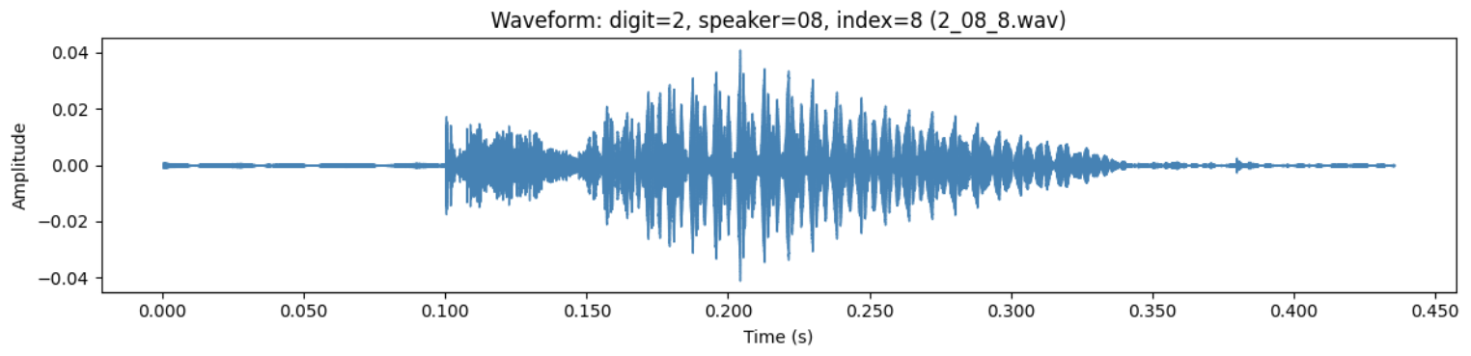
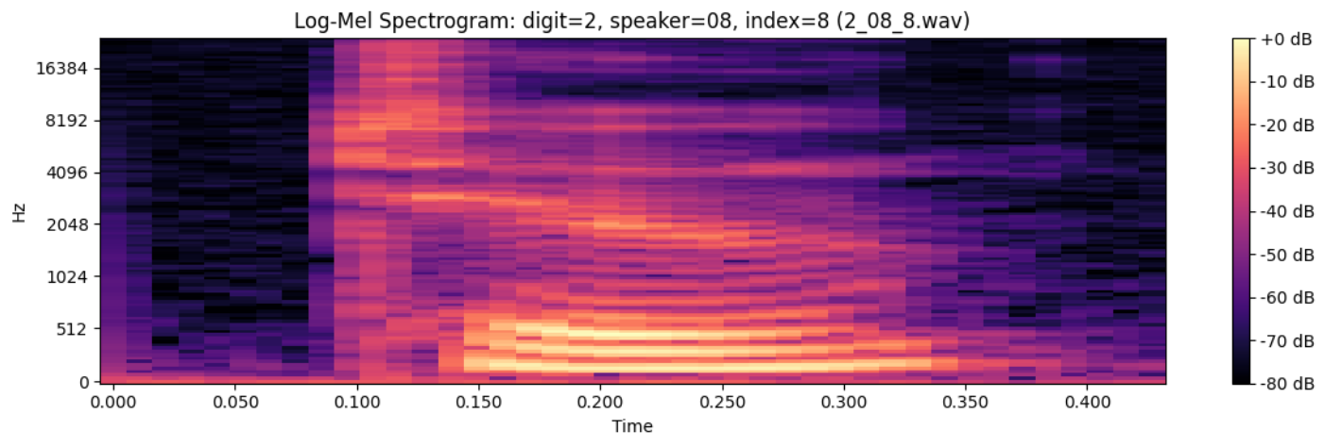
Audio Preprocessing
Transformed raw .wav audio signals into log-scaled Mel spectrograms using the librosa library
This representation captures both the temporal and frequency features of speech
Spectrograms are then normalized and verified using a dedicated checking script
7 of 19
Notes:
ZSOLT

Slide 8
Baseline CNN
Well-suited to 2D time-frequency data because they can detect localized patterns through shared convolutional filters
Model design:
Two convolutional layers with ReLU activation and batch normalization
Max pooling after each convolution
Dropout regularization
Fully connected dense layers
10-class softmax output.
Best model based on highest validation accuracy was identified at epoch 28
8 of 19
Notes:
ZSOLT

Slide 9
Improved CNN
Fixed-length log-Mel spectrogram inputs for consistent time–frequency dimensions
Dataset-level mean–variance normalization (CMVN) for stable feature distributions
Controlled data augmentation: SpecAugment masking, mild time-stretching, low-level additive noise
Deeper CNN with 3 convolutional blocks (32–64–128 channels) plus batch normalization, pooling, and tuned dropout
Trained with Adam optimizer, cross-entropy loss, adaptive learning-rate scheduling, and early stopping
Designed to improve robustness to speaker variation and recording differences compared with the baseline CNN
9 of 19
Notes:
ZSOLT

Slide 10
RNN
Uses bidirectional GRU layers to capture temporal structure in the spoken-digit recordings
Operates on the same log-Mel spectrogram features used by the CNN models
Trained using standard supervised learning with cross-entropy loss and gradient-based optimization
Designed to model the sequential evolution of speech more effectively than convolution-only architectures
Expected to perform well when timing and order of acoustic events carry important discriminative information
10 of 19
Notes:
ZSOLT

Slide 11
Results
RNN performed the best, with a 99.2% test accuracy.
CNNs learn meaningful spectral features but benefit significantly from normalization, fixed-length inputs, and augmentation.
RNNs excel when temporal structure carries important discriminative information, as in short spoken-digit recordings.
11 of 19
Notes:
JAN
Here is the big picture.
Out of all three models, the RNN clearly performed the strongest, reaching a 99.2 percent test accuracy.
The CNN models learned meaningful spectral patterns, but they really improved only after we added normalization, fixed-length inputs, and augmentation.
The RNN did well because it follows how the sound changes through time, which is especially helpful for short spoken-digit recordings.

Slide 12
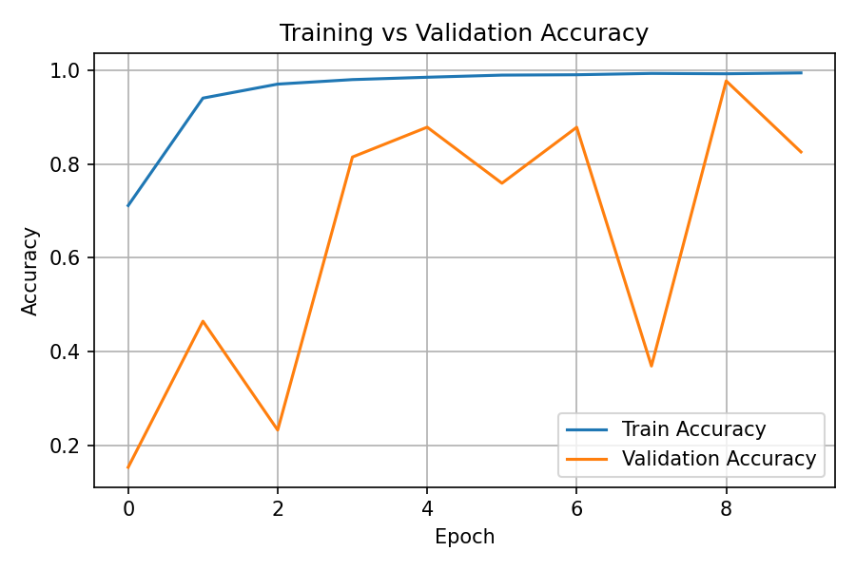
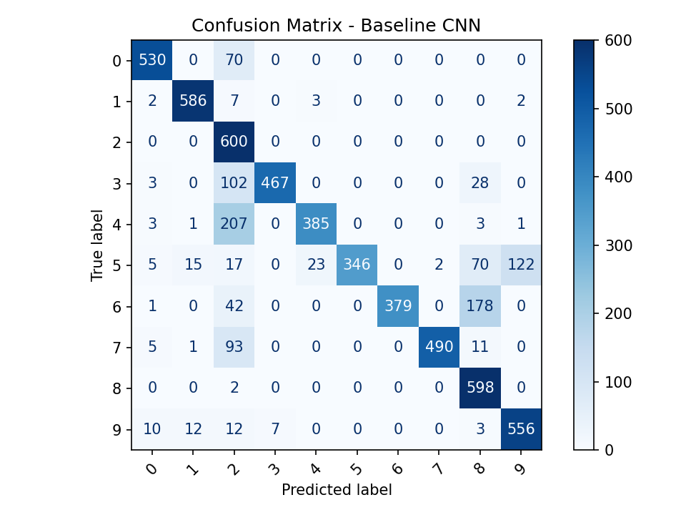
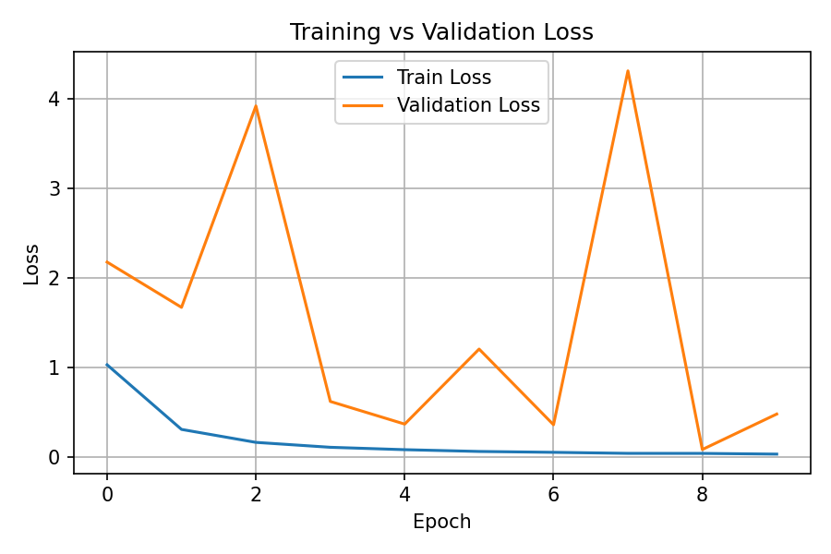
Baseline CNN
Performed the worst out of the three models due to underfitting and low model depth
68.9% training accuracy, 80.6% validation accuracy, 80.7% test accuracy
12 of 19
Notes:
JAN
The baseline CNN struggled compared to the other two models. Its final training accuracy was 68.9 percent, which tells us it never fully learned the patterns in the training set.
Validation accuracy landed at 80.6 percent, with a test accuracy of 80.7 percent, so it generalized only moderately well.
The validation accuracy jumped around from epoch to epoch, and the loss curve showed the same instability.
That usually means the model is too shallow for the task and does not form consistent internal representations.
The confusion matrix confirms this, with frequent mistakes among digits that share similar spectral shapes, such as 4, 5, and 9.

Slide 13
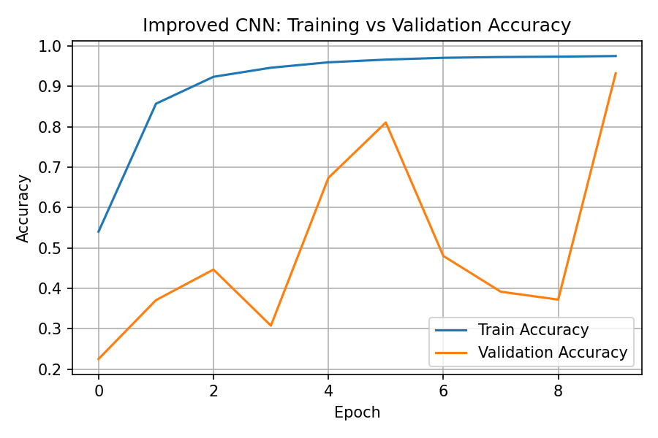
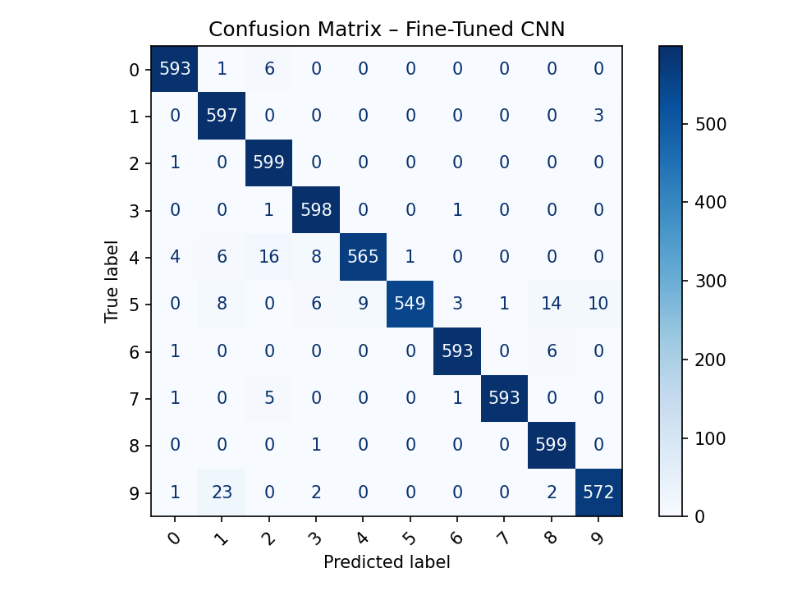
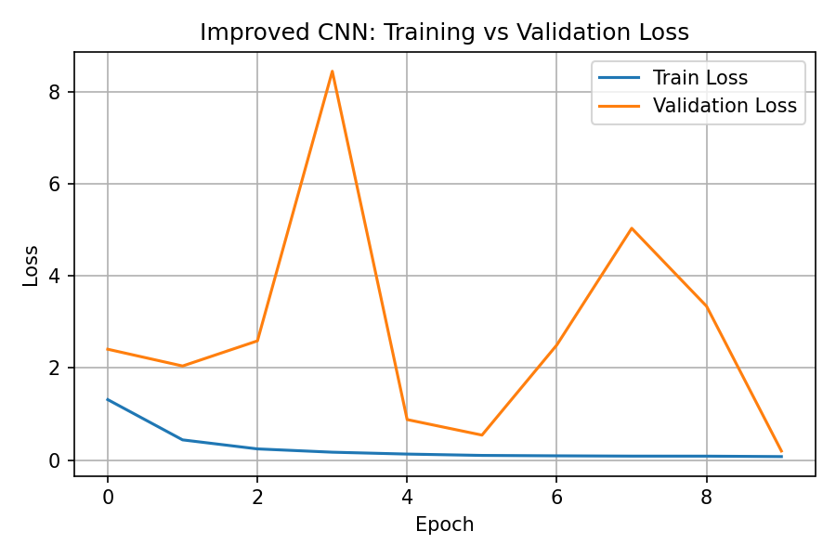
Improved CNN
Stronger performance with 90% validation accuracy
Cleaner training curve, with accuracy climbing steadily
13 of 19
Notes:
JAN
The improved CNN landed in a much better spot.
Validation accuracy rose to about 90 percent, and the confusion matrix shows far fewer misclassifications.
The training curve also looks cleaner, with accuracy climbing steadily and less volatility in the validation line.
The loss curves tell the same story, with lower variation and more stable convergence.
The improvements came from stronger preprocessing, normalization, and larger convolutional capacity.
These changes allowed the model to learn clearer spectral patterns and handle differences between speakers more consistently.

Slide 14
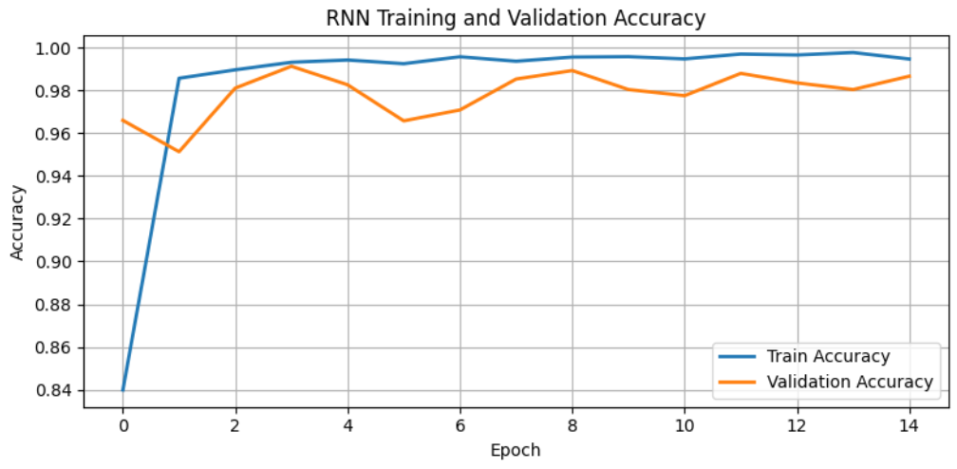
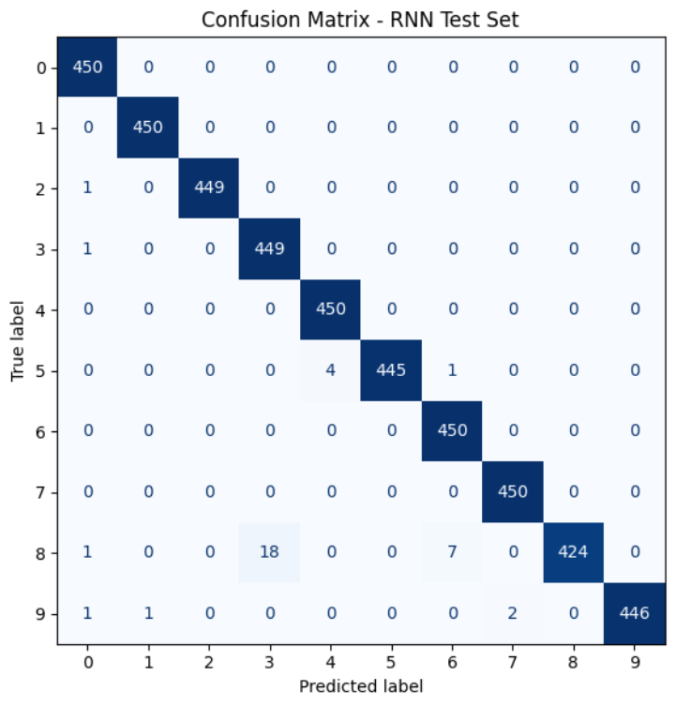
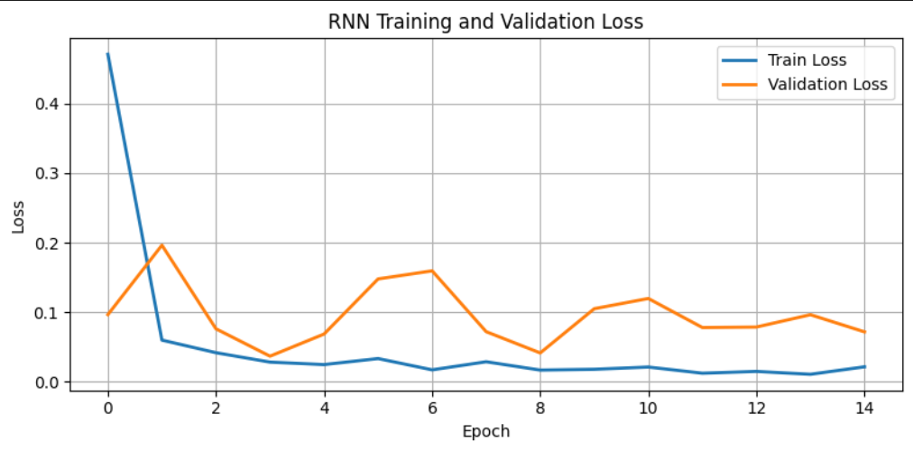
RNN
Achieved a 99.9% training accuracy, 98.7% validation accuracy, and a 99.2% test accuracy
Loss curves show minimal divergence and sustained low validation loss
14 of 19
Notes:
JAN
The RNN outperformed both CNNs by a wide margin.
It reached 99.9 percent training accuracy and maintained strong generalization with 98.7 percent validation accuracy and a 99.2 percent test accuracy.
The accuracy curves show the model locking onto the correct patterns within the first few epochs and then staying steady.
Loss curves barely drift apart, which means the model kept a good balance between learning the training data and handling new samples.
The confusion matrix reflects this stability, with almost every prediction falling in the correct cell.
The RNN’s ability to follow the signal through time made it particularly effective for this spoken-digit task.

Slide 15
Limitations
AudioMNIST is a clean and constrained database and real-world audio is rarely this clean.
Did not evaluate deeper convolutional stacks, transformer-based models, or hybrid combinations.
Our study primarily used accuracy and loss to assess performance. Additional metrics could include precision, recall, and sensitivity to quieter inputs.
15 of 19
Notes:
JAN
Even though the results look strong, we do need to keep the limitations in mind.
AudioMNIST is a very clean dataset, and most real-world recordings are not.
We also did not explore deeper CNNs, transformers, or hybrid designs.
Finally, our evaluation focused only on accuracy and loss, so we do not yet know how these models would handle more detailed performance questions such as per-speaker variation or sensitivity to quiet recordings.

Slide 16
Conclusion
The RNN baseline was the most effective model for spoken-digit recognition on this dataset.
The improved CNN showed that preprocessing choices and augmentation play a major role in model stability and accuracy.
CNNs and RNNs learn different aspects of the audio, with CNNs focusing on spectral structure and RNNs capturing temporal patterns.
The project provides a practical comparison of these architectures and sets the stage for future work with more complex, real-world audio.
16 of 19
Notes:
JAN
To wrap up, the RNN baseline was the clear winner and handled the temporal structure of speech extremely well.
The improved CNN also performed strongly and reminded us that preprocessing can make or break a model.
The two architectures learn different things, and looking at them side by side gives us a better understanding of how each interprets sound.
Taken together, these models form a solid foundation that we could extend later by testing more diverse datasets or newer architectures.

Slide 17
References
Becker, S., Vielhaben, J., Ackermann, M., Müller, K.-R., Lapuschkin, S., & Samek, W. (2023). AudioMNIST: Exploring explainable artificial intelligence for audio analysis on a simple benchmark. Journal of the Franklin Institute. Advance online publication. https://doi.org/10.48550/arXiv.1807.03418
Bishop, C. M. (2006). Pattern recognition and machine learning. Springer.
Géron, A. (2019). Hands-on machine learning with Scikit-Learn, Keras, and TensorFlow (2nd ed.). O’Reilly Media.
Goodfellow, I., Bengio, Y., & Courville, A. (2016). Deep learning. MIT Press.
Ioffe, S., & Szegedy, C. (2015). Batch normalization: Accelerating deep network training by reducing internal covariate shift. Proceedings of the 32nd International Conference on Machine Learning (ICML 2015) (pp. 448-456).
Jeong, S.-M., Kim, S., Lee, E. C., & Kim, H. J. (2024, July 17). Exploring Spectrogram-Based Audio Classification for Parkinson’s Disease: A Study on Speech Classification and Qualitative Reliability Verification. MDPI. https://www.mdpi.com/1424-8220/24/14/4625
Kingma, D. P., & Ba, J. (2015). Adam: A method for stochastic optimization. arXiv preprint arXiv:1412.6980. https://doi.org/10.48550/arXiv.1412.6980
Logan, B. (2000). Mel frequency cepstral coefficients for music modeling. Proceedings of the International Symposium on Music Information Retrieval (ISMIR 2000), 23-25.
17 of 19

Slide 18
References
McConnell, J., Grabar, S., Graham, J., & Kiss, Z. (2025). DS620 team project: Applying deep learning techniques for audio pattern recognition with AudioMNIST [Computer software]. GitHub. https://github.com/janmcconnellCityU/DS620_Team_Project
Purwins, H., Li, B., Virtanen, T., Schlüter, J., Chang, S.-Y., & Sainath, T. (2019). Deep learning for audio signal processing. IEEE Journal of Selected Topics in Signal Processing, 13(2), 206-219. https://doi.org/10.1109/JSTSP.2019.2908700
Srinivasan, S. (2021). Audio MNIST dataset [Data set]. Kaggle. Retrieved October 12, 2025, from https://www.kaggle.com/datasets/sripaadsrinivasan/audio-mnist
Srivastava, N., Hinton, G., Krizhevsky, A., Sutskever, I., & Salakhutdinov, R. (2014). Dropout: A simple way to prevent neural networks from overfitting. Journal of Machine Learning Research, 15(1), 1929-1958.
Trask, A. W. (2019). Grokking deep learning. Manning Publications.
Wolf-Monheim, F. (2024, October 9). Spectral and rhythm features for audio classification with deep convolutional Neural Networks. https://arxiv.org/html/2410.06927v1
Zaman, K., Sah, M., & Direkoglu, C. (2023, January). A Survey of Audio Classification Using Deep Learning. ResearchGate. https://www.researchgate.net/publication/374101086_A_Survey_of_Audio_Classification_using_Deep_Learning
18 of 19

Slide 19
Thank you!
19 of 19

